Slide 1
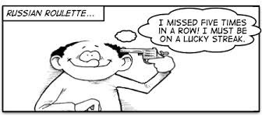
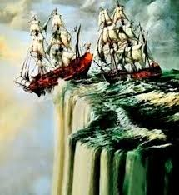
Bandwagon
An argument support by popular recognition, from peer pressure, or threat, causing the individual to change perspective whether maintained by evidence or not.
Everyone believes there is one million dollars at the bottom of that cliff but, once you jump off there's no climbing back up. No one has returned. So go ahead and crack your own head open for money.

